Slide 1
Building A Basic Firewall

Slide 2
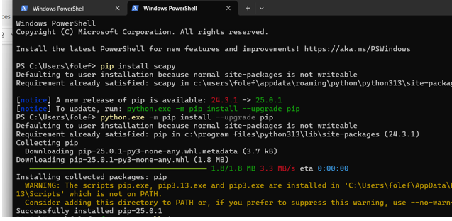

Slide 3
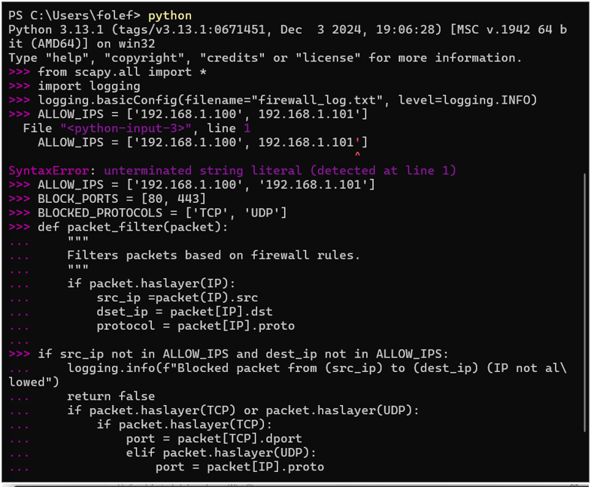
The logging.basicConfig(): Configures logging to write output to a file named firewall_log.txt at the INFO level. This means that messages of level INFO and higher e.g., WARNING, ERROR will be logged.
ALLOWED_IPS: This list holds the IP addresses that are allowed to send or receive traffic. In this case, only 192.168.1.100 and 192.168.1.101 are allowed.
BLOCKED_PORTS: This contains the port numbers (80 for HTTP and 443 for HTTPS) that are blocked. Any traffic targeting these ports will be dropped.
BLOCKED_PROTOCOLS: This list also contains the protocols (TCP and UDP) that are blocked. If a packet uses one of these protocols, it will be blocked.

Slide 4
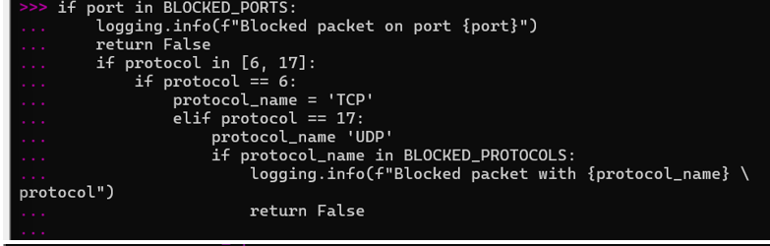
Blocked Ports Check: If the packet is using TCP or UDP, it checks if the destination port (dport) is in the list of blocked ports (BLOCKED_PORTS). If it is, the packet is blocked and logged.
Blocked Protocols Check: If the protocol is either TCP (protocol number 6) or UDP (protocol number 17), it checks if the protocol is in the blocked protocols list (BLOCKED_PROTOCOLS). If it is, the packet is blocked and logged.
Logging: Each time a packet is blocked, a log message is generated, and for allowed packets, a different log message is created.
Return: If the packet passes all checks, it is allowed and returned True; otherwise, it is blocked and returns False.

Slide 5
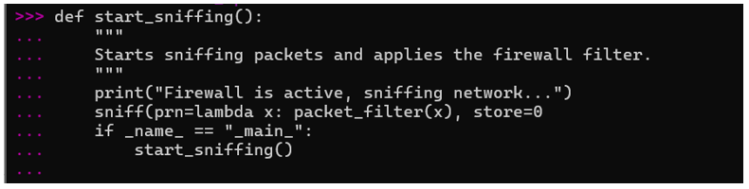
start_sniffing(): This function starts packet sniffing.
sniff(prn=lambda x: packet_filter(x), store=0): The sniff() function is used to capture packets from the network. The prn argument specifies a callback function that will be executed for each captured packet. In this case, it calls packet_filter(x) where x is the captured packet.
store=0: This tells scapy not to store the sniffed packets in memory.
if __name__ == "__main__":: This ensures that the start_sniffing() function is executed when the script is run directly rather than being imported as a module.
start_sniffing(): Calls the function to start sniffing packets and apply the firewall rules.

Slide 6
Summary of How It Works
The firewall filters incoming and outgoing network traffic based on predefined rules (allowed IPs, blocked ports, and blocked protocols).
It logs the activity (both blocked and allowed packets) into a file called firewall_log.txt.
The firewall uses scapy to capture packets from the network and apply these rules in real-time.
If any packet violates one of the rules, it is blocked and logged; otherwise, the packet is allowed through.

Slide 7
